Slide 1
Database Management System Lab 2: Basic SQL
逢甲資工 廖柏瑜

Slide 2
練習環境
W3C 的 SQL Tryit Editor
https://www.w3schools.com/sql/
https://goo.gl/Fg2p0d

Slide 3
Review

Slide 4
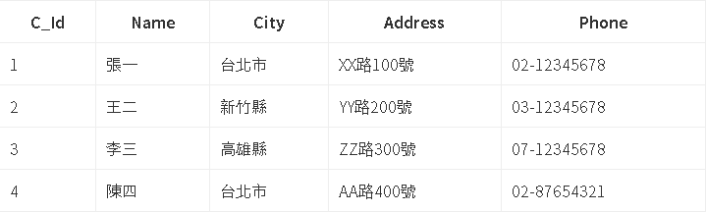
SELECT 語法
SELECT * FROM customers;
SELECT C_ID FROM customers;

Slide 5
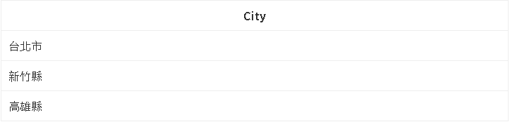
DISTINCT
SELECT DISTINCT City FROM customers;

Slide 6
Lab 2
請列出顧客們所居住的城市清單(不重複)
SELECT DISTINCT City FROM Customers;

Slide 7
設定搜尋的條件
SELECT col_name[,column_name] FROM table_name WHERE col_name operator value;
Operator =, <>, >, <, >=, <=, BETWEEN, LIKE, IN

Slide 8
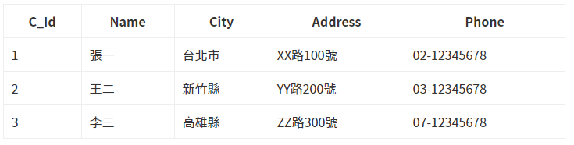
IN
customers

Slide 9
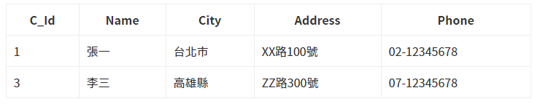
IN
SELECT * FROM customers WHERE Name IN ('張一', '李三');

Slide 10
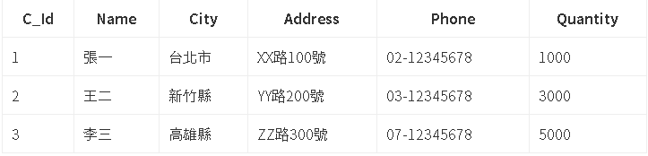
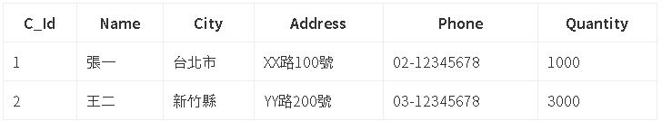
BETWEEN
選取Quantity介於1000至4000之間
SELECT * FROM customers WHERE Quantity BETWEEN 1000 AND 4000;
customers

Slide 11
用 AND/OR 連結多個條件
SELECT * FROM Products WHERE SupplierID = 20 AND Price < 20;
SELECT * FROM Customers WHERE Country = 'Germany' OR City = 'London';
AND : 同時包含，以上述例子就是同時包含SupplierID = 20 與 Price < 20時，才列出內容。
OR : 只要其中一項成立即列出。

Slide 12
依序列出
SELECT col_name, [col_name] FROM table_name ORDER BY col_name ASC|DESC[, col_name ASC|DESC];
ASC : 由低至高
DESC : 由高至低
SELECT ProductName FROM Products ORDER BY Price ASC;
SELECT LastName,FirstName FROM Employees ORDER BY BirthDate DESC;

Slide 13
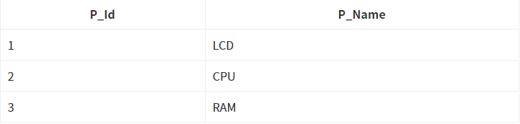
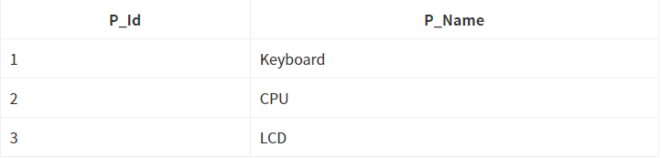
UNION
products_taiwan
products_china

Slide 14
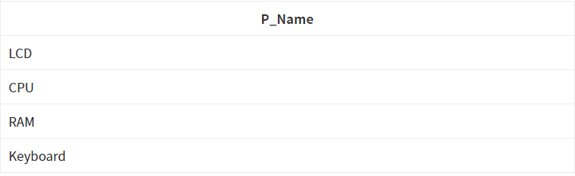
UNION
SELECT P_Name FROM products_taiwan UNION SELECT P_Name FROM products_china;

Slide 15
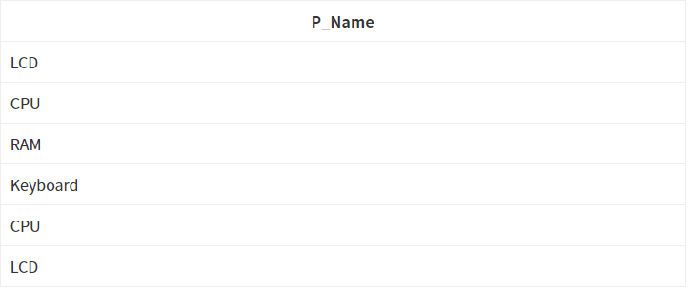
UNION ALL
UNION ALL 則會列出所有的資料，不論是否重複。
SELECT P_Name FROM products_taiwan UNION ALL SELECT P_Name FROM products_china;

Slide 16
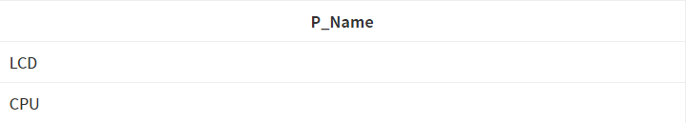
INTERSECT
SELECT P_Name FROM products_taiwan INTERSECT SELECT P_Name FROM products_china;

Slide 17
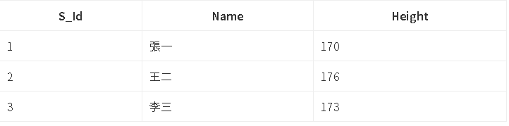

取平均
AVG() 函數用來計算一數值欄位的平均值。
SELECT AVG(Height) FROM students;
students

Slide 18
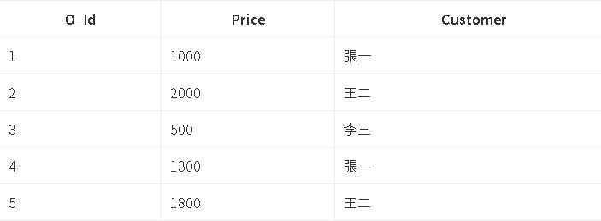

最大值
MAX() 函數用來取得特定欄位中的最大紀錄值。
SELECT MAX(Price) FROM orders;
orders

Slide 19

最小值
MIN() 函數用來取得特定欄位中的最小紀錄值。
SELECT MIN(Price) FROM orders;
orders

Slide 20

總數
SUM() 函數用來計算一數值欄位的總合。
SELECT SUM(Price) FROM orders;
orders

Slide 21
Aggregate
彙整一個資料集的值
取平均、最大值、最小值、計數、總數等
請嘗試下列 SQL 指令
SELECT avg(price) FROM Products WHERE SupplierID=1;
SELECT max(price) FROM Products WHERE SupplierID=1;
SELECT min(price) FROM Products WHERE SupplierID=1;

Slide 22
問題討論
找出顧客所居住的國家(不重複且國家名稱在Mexico後面)，用後續法排序回來。

Slide 23
W3school練習
https://www.w3schools.com/sql/exercise.asp
SQL Select
SQL Where
SQL Order By

Slide 24
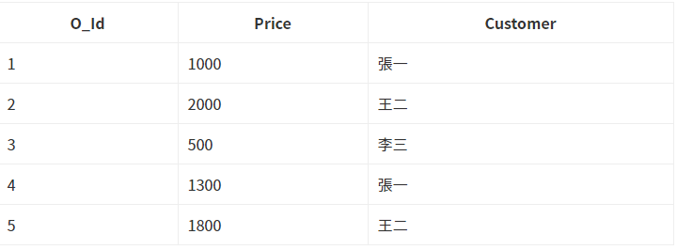
Count
COUNT() 函數用來計算符合查詢條件的欄位紀錄總共有幾筆。
orders

Slide 25


Count
SELECT COUNT(*) FROM orders;
SELECT COUNT(Customer) FROM orders WHERE Customer='張一';

Slide 26

Count
SELECT COUNT(DISTINCT Customer) FROM orders;

Slide 27
Aggregate (cont.)
請嘗試下列指令
SELECT count(customerID) FROM Orders WHERE EmployeeID=3;
SELECT count(distinct customerID) FROM Orders WHERE EmployeeID=3;
SELECT count(*) FROM Orders WHERE EmployeeID=3;
SELECT sum(Quantity) FROM OrderDetails WHERE ProductID=2;

Slide 28
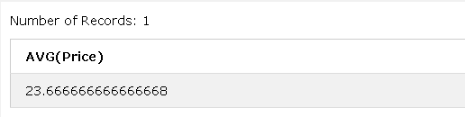
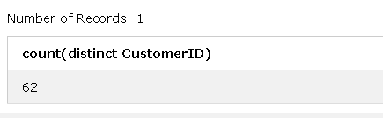
Lab 7
請列出供應商1與3所提供之全部產品的平均價格(Products)
請列出雇員1至5，其曾經締結訂單的之客戶(不重複)總共有多少位(Orders)

Slide 29
NULL Values
查看欄位是否有任何空值。
SELECT column_names FROM table_name WHERE column_name IS NULL;

Slide 30
NULL Values
Try it
SELECT CustomerName, ContactName, Address FROM Customers WHERE Address IS NULL;

Slide 31
Lab8
1. 查看OrderDetails中是否有任何產品ID有遺失值的
2. 從Suppliers中列出沒有國家缺失值的SupplierName及 Address

Slide 32
SQL SELECT TOP
SQL TOP子句用於從表中獲取一個TOP N數字或X%的紀錄。
Mysql使用limit子句來獲取紀錄。

Slide 33
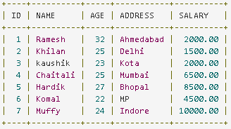
SQL SELECT TOP
SELECT TOP number|percent column_names(s) From table_name WHERE [condition]
CUSTOMERS

Slide 34
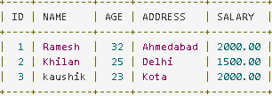
SQL SELECT TOP
選取前三筆資料的紀錄
SELECT TOP 3 * FROM CUSTOMERS;

Slide 35
SQL SELECT TOP
SELECT * FROM CUSTOMERS LIMIT 3;

Slide 36
LAB 9
查看前五筆顧客中住在德國的顧客姓名以及地址。

Slide 37
GROUP BY
GROUP BY 敘述句搭配 (aggregation function) 使用，是用來將查詢結果中特定欄位值相同的資料分為若干個群組，而每一個群組都會傳回一個資料列。若沒有使用 GROUP BY，聚合函數針對一個 SELECT 查詢，只會返回一個彙總值。
aggregation function指的也就是 AVG()、COUNT()、MAX()、MIN()、SUM() 等這些內建函數。

Slide 38
GROUP BY
SELECT column_name(s), aggregate_function(column_name) FROM table_name WHERE column_name operator value GROUP BY column_name1, column_name2...;

Slide 39
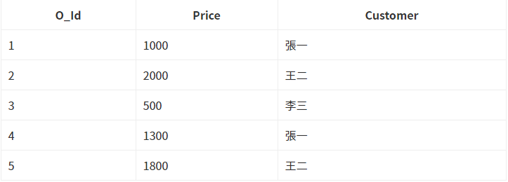
GROUP BY
orders

Slide 40
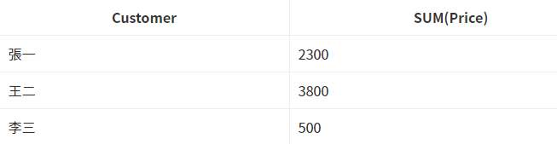
GROUP BY
查看每一個顧客的總花費是多少
SELECT Customer, SUM(Price) FROM orders GROUP BY Customer;

Slide 41
Aggregate (more...)
假如想要對所有供應商、對所有雇員做彙整呢？
請嘗試下列指令
SELECT SupplierID, avg(price) FROM Products GROUP BY SupplierID;
SELECT EmployeeID, count(distinct CustomerID) FROM Orders GROUP BY EmployeeID;

Slide 42
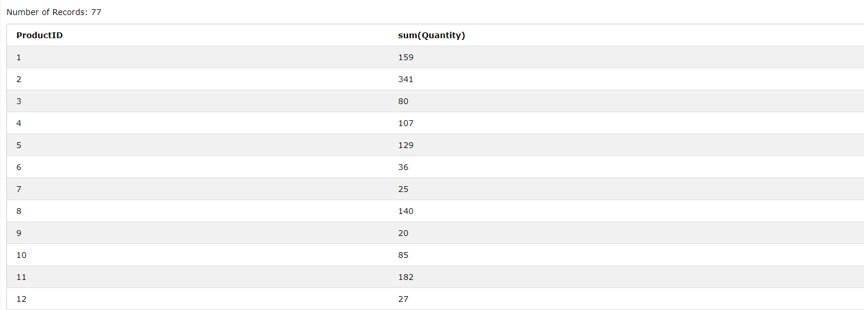
Lab 10
試列出各項商品分別的總銷售量(OrderDetails)

Slide 43
Aggregate (more.)
請嘗試下列指令
SELECT CustomerID, EmployeeID, count(*) as num_trans FROM Orders GROUP BY CustomerID, EmployeeID;

Slide 44
Alias(AS)
在 SQL 中我們可以替資料表或欄位名稱取一個別名 (Alias)，這可以使名稱複雜的 SQL 查詢語句更易讀且可以有更直觀的查詢結果。
SELECT table_column AS alias_name FROM table_name;
這樣顯示出來的畫面，就是table_column名稱變成alias_name

Slide 45
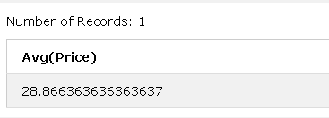
Aggregate (more…)
試找出Products裡面的平均價格，並將平均價個的column name取為Average_Price。
SELECT Avg(Price) FROM Products

Slide 46
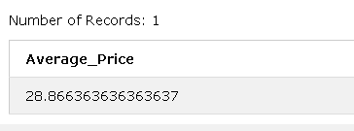
Aggregate (more…)
SELECT Avg(Price) as Average_Price FROM Products

Slide 47
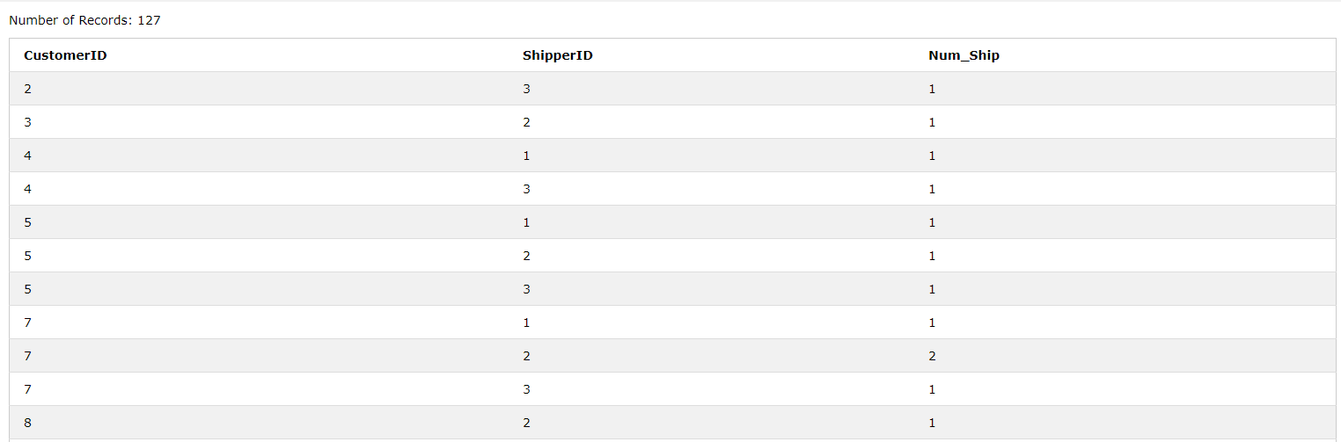
Lab 11
試統計透過個別物流業者(ShipperID)向不同客戶(CustomerID)送貨的次數，將次數取名為Num_Ship(Orders)

Slide 48
Having
HAVING 子句是用來取代 WHERE 搭配聚合函數 (aggregate function) 進行條件查詢，因為 WHERE 不能與聚合函數一起使用。
就是Group by版本的where條件^^

Slide 49
Having
SELECT column_name(s), aggregate_function(column_name) FROM table_name WHERE column_name operator value GROUP BY column_name1, column_name2... HAVING aggregate_function(column_name) operator value;

Slide 50
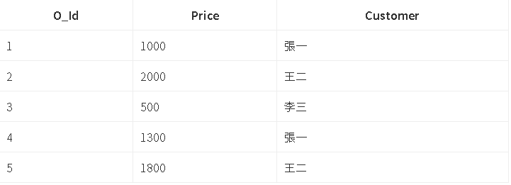
Having
orders 資料表中查詢訂單金額總合小於 1000 的顧客
orders

Slide 51

Having
SELECT Customer, SUM(Price) FROM orders GROUP BY Customer HAVING Sum(Price) < 1000;

Slide 52
Aggregate (more…)
假如我想對彙整的結果設定條件？
請嘗試下列指令
從Orders中找出交易次數大於一次的消費者與員工

Slide 53
Aggregate (more…)
SELECT CustomerID, EmployeeID, count(*) as num_trans FROM Orders GROUP BY CustomerID, EmployeeID HAVING num_trans > 1;

Slide 54
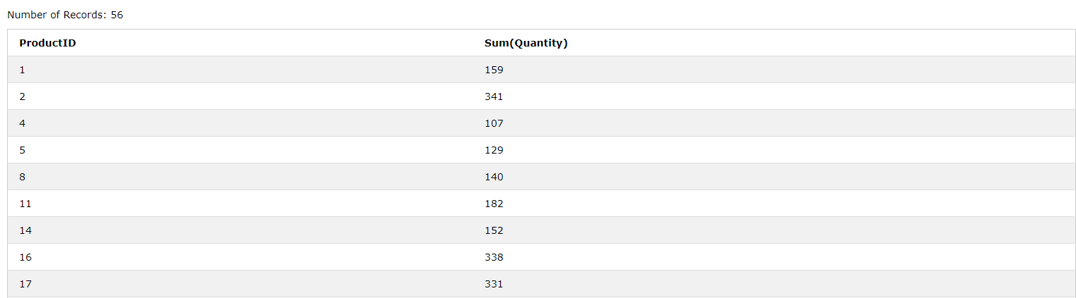
Lab 12
試列出出貨量超過 100 的商品，其商品ID與出貨量(OrderDetails)
試列出達成交易次數不足 10 次的員工(Orders)

Slide 55
複合查詢
將查詢的結果作為條件的一部分
列出所有出貨量大於平均出貨量的訂單明細(OrderDetails)
SELECT * FROM OrderDetails WHERE Quantity > (SELECT avg(Quantity) FROM OrderDetails);

Slide 56
複合查詢 (cont.)
列出顧客4過去的訂單明細(OrderDetails)(Orders)
SELECT * FROM OrderDetails WHERE OrderID IN (SELECT OrderID FROM Orders Where CustomerID=4);

Slide 57
Exists
EXISTS 運算子可以連接子查詢，用來判斷子查詢是否有返回的結果，如果有結果返回則為真、否則為假。若 EXISTS 為真，就會繼續執行外查詢中的 SQL；若 EXISTS 為假，則整個 SQL 查詢就不會返回任何結果。

Slide 58
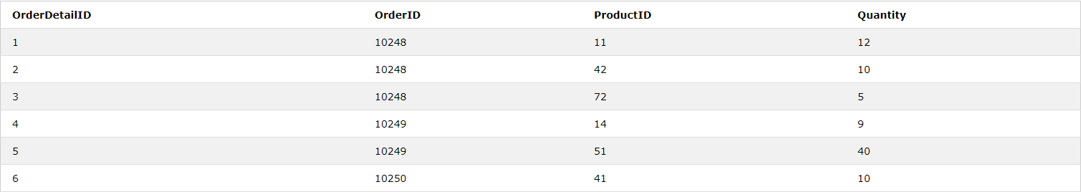
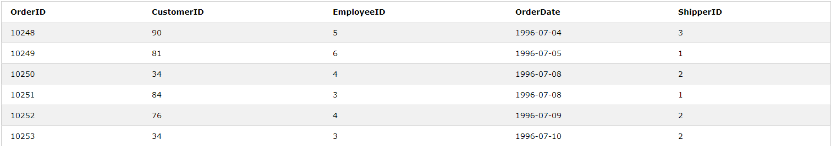
複合查詢 (cont.)
列出顧客4過去的訂單明細
OrderDetails
Orders

Slide 59
複合查詢 (cont.)
列出顧客4過去的訂單明細
SELECT * FROM OrderDetails WHERE EXISTS(SELECT * FROM Orders WHERE OrderID=OrderDetails.OrderID AND CustomerID=4);
SELECT * FROM OrderDetails WHERE OrderID IN (SELECT OrderID FROM Orders WHERE CustomerID=4);

Slide 60
複合查詢 (cont.)
列出僅訂購了一種商品的訂單(Orders)(OrderDetails)
SELECT * FROM Orders WHERE (SELECT count(ProductID) FROM OrderDetails WHERE OrderID=Orders.OrderID GROUP BY OrderID) = 1;
SELECT * FROM Orders WHERE OrderID IN (SELECT OrderID FROM OrderDetails GROUP BY OrderID HAVING count(productID) = 1);

Slide 61
複合查詢 (cont.)
列出出貨總量超過 100 的商品名稱與其銷售量
SELECT * FROM (SELECT ProductID, Sum(Quantity) as Total_Quantity FROM OrderDetails GROUP BY ProductID) WHERE Total_Quantity > 100;
SELECT ProductID, Sum(Quantity) FROM OrderDetails GROUP BY ProductID HAVING Sum(Quantity) > 100;

Slide 62
Lab 13
列出出貨量最大的出貨明細(OrderDetails)
Hint : 先列出orderDetails裡最大的max(Quantity)
再去搜尋哪一筆資料是orderDetails裡的max(Quantity)
SELECT裡面再去SELECT

Slide 63
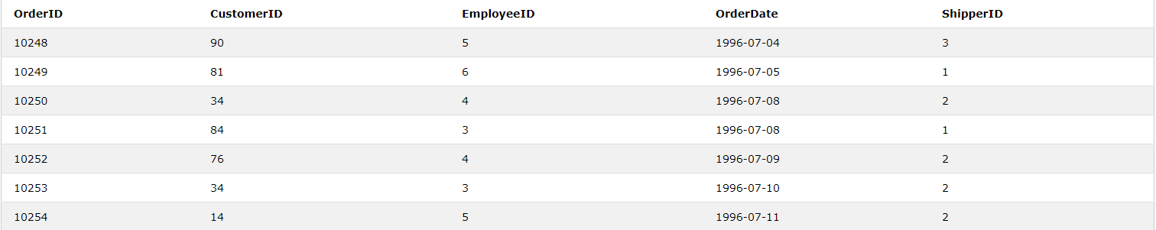
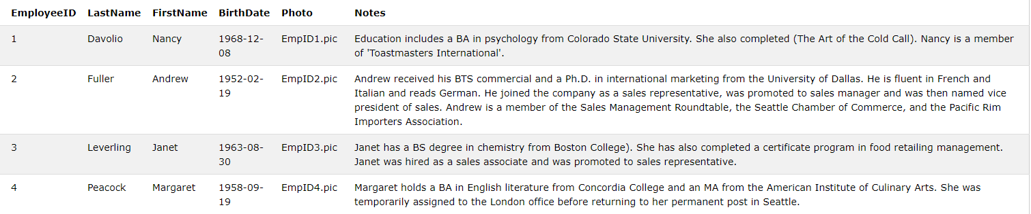
Lab 13
列出曾經與顧客4進行交易的員工資料(EmployeeID)(Orders)
Orders
Employees

Slide 64
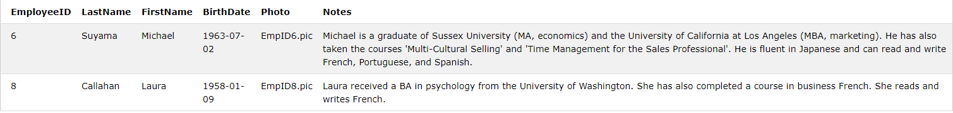
Lab 13

